Slide 1
Smart Motion Detecter

Slide 2
Introduction
This device checks the motion using PIR sensor and give three types of output
SMS Alert
Buzzer Output
Smoke sensor

Slide 3
Objectives

Slide 4
Plan
Motion
detect
Controller
Buzzer
SMS
Alert
Smoke

Slide 5
Hypothesis
Make experiments with PIR sensor
Learn about GSM Module
Learn about C Programming

Slide 6
Materials
Atmega328 microcontroller
PIR Sensor
GSM module
Buzzer
Encloser Box
Copper Board

Slide 7
Procedure
PIR sensor was tested with busser
PIR sensor delay time and sensitive level was adjusted
GSM Module was tested using pc com port
Buzzer was tested using 12v power supply
Circuit diagram was drawn using eagle cad software
Circuit board was made using pcb etching method and components were soldered
The device was tested using simple motion

Slide 8

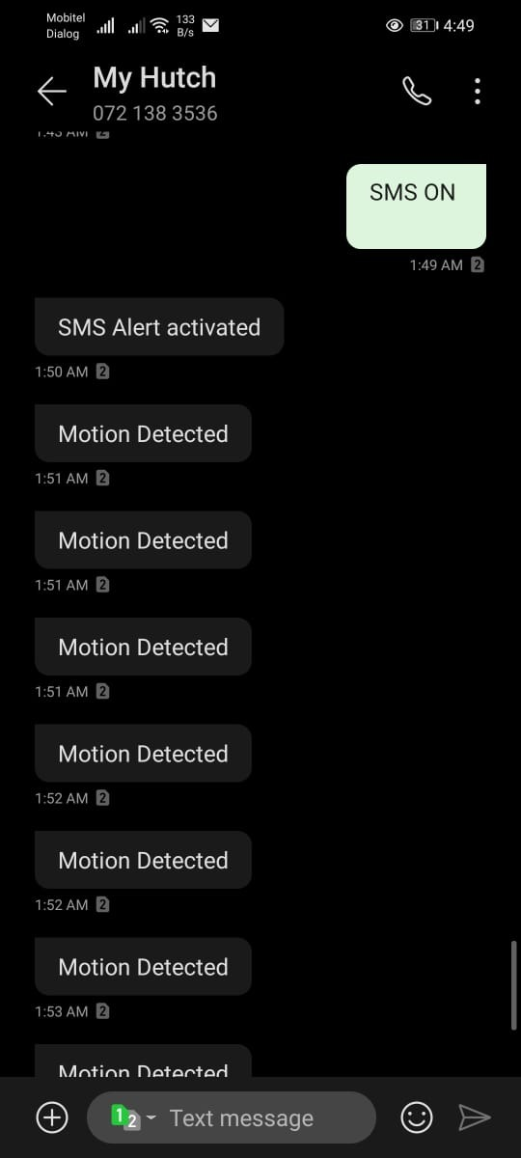
Results

Slide 9
Conclusion

